Slide 1

Emergency Action Plan

Slide 2
Emergency Drills
Fire Drill - A practice of the emergency procedures to be used in case of fire.
Tornado Drill - A procedure of practicing to take cover in a specified location in the event that a tornado strikes an area.
Earthquake Drill - A procedure for people in homes, schools, and organizations to practice what to do during earthquakes, and to improve preparedness.
Lockdown Drill - A set of procedures designed to have the occupants in a building familiarize themselves with ways to protect themselves against a threat, such as an armed intruder.

Slide 3
When you see the symbol on the screen, perform the action!
🔥=Crawl
🌪=Spin
🪨=Quick Feet
🏠=Squat

Slide 4
FIRE
🔥

Slide 5
TORNADO
🌪

Slide 6
EARTHQUAKE
🪨

Slide 7
LOCKDOWN
🏠

Slide 8
EARTHQUAKE
🪨

Slide 9
FIRE
🔥

Slide 10
LOCKDOWN
🏠

Slide 11
TORNADO
🌪

Slide 12
TORNADO
🌪

Slide 13
EARTHQUAKE
🪨

Slide 14
LOCKDOWN
🏠

Slide 15
FIRE
🔥

Slide 16
LOCKDOWN
🏠

Slide 17
TORNADO
🌪

Slide 18
FIRE
🔥

Slide 19
EARTHQUAKE
🪨

Slide 20
Closure Activity
Draw An
Emergency Action Plan!

Slide 21
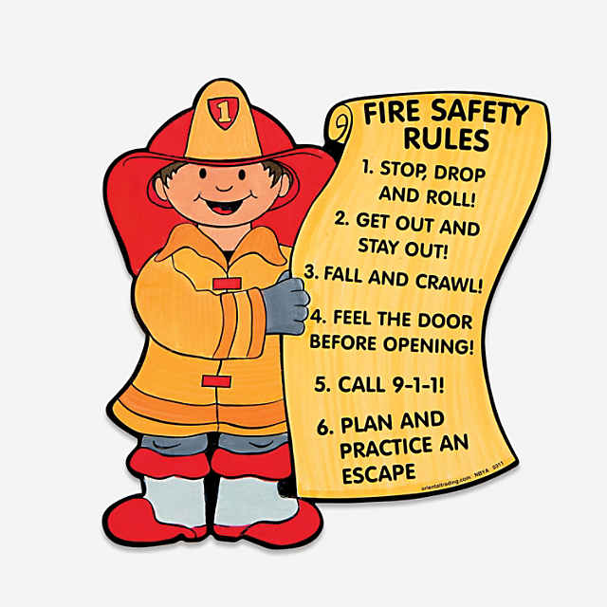
Fire
Create a Drawing
Make sure to include
Smoke Alarms
Stop, Drop, & Roll
Escape Plan
Crawl/Stay Low

Slide 22


Lockdown
Create a Drawing
Make sure to include
Keep Doors Locked
Hiding
Lights off
No windows

Slide 23
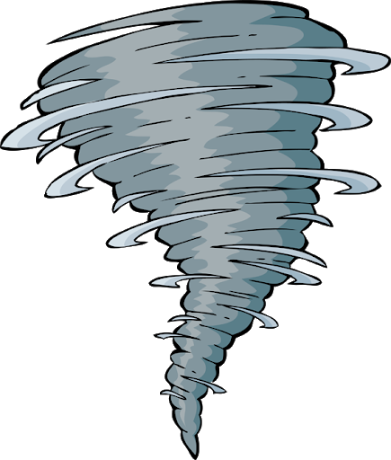
Tornado
Create a Drawing
Make sure to include
Gather Supplies
Duck and cover
Keep away from glass
Have a plan

Slide 24
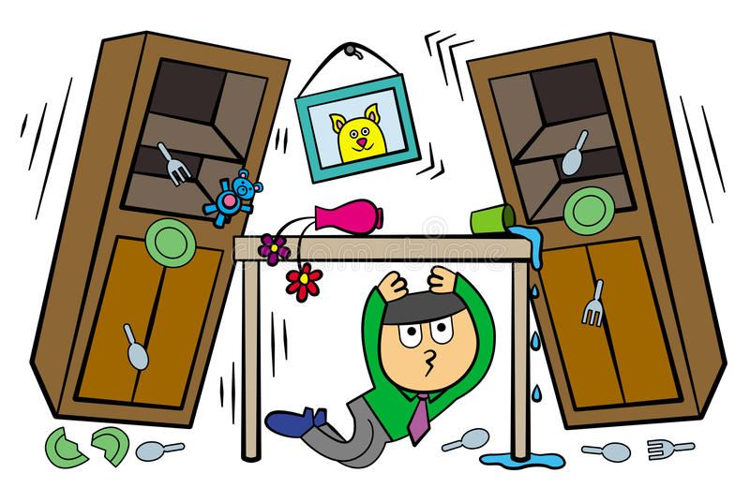
Earthquake
Create a Drawing
Make sure to include
Gather Supplies
Duck and cover
Keep aways from glass
Have a plan

Slide 25
